Slide 1

A Socially Relevant Project -I presentation on IOT BASED AIR POLLUTION CONTROLLING MONITORING SYSTEM
Presented by Batch No: SRP-CSE-19-D-08
Veeramreddy Akash kumar Reddy 19121A05R8
Tharimala Rajesh 19121A05P8
Bhanu Kiran G 20125A0525
Ankamreddi Poorna Priyanka 20125A0501
Sarabu Sai Likith 18121A05L4
Computer Science and Engineering
Under the guidance of
Ms.K.Ghamya
Assistant Professor
Dept. of CSE
HOD:
Dr. B. Narendra Kumar Rao,
Professor & Head,
Dept. of CSE

Slide 2
CONTENTS
➢ Abstract
➢ Introduction
➢ Problem Statement
➢ Objectives
➢ System Requirements
➢ Existing Systems
➢ System Requirement Specification (SRS) Document Report
Preparation
➢ Proposed System
➢ Algorithm and Explanation
➢ Design
➢ Implementation
➢ Screenshots
➢ Conclusion
➢ References
➢ Queries

Slide 3
Abstract
Now-a-days, the level of pollution has increased with times by lot of factors like the increase in population, increased vehicle use, industrialization and urbanization which results in harmful effects on human wellbeing by directly affecting health of population exposed to it. In IOT Based Air Pollution Monitoring System the Air Quality is measured over a web server using internet and will trigger a alarm when the air quality goes down beyond a certain level, means when there are sufficient amount of harmful gases are present in the air like CO2, smoke ,alcohol, benzene

Slide 4
and NH3.It will show the air quality in PPM on the LCD and as well as on webpage so that we can monitor it very easily. MQ135 sensor which is the best choice for monitoring Air Quality as it can detects most harmful gases and can measure their amount accurately .The pollution level can be monitored anywhere using computer or mobile. Install the Iot Based Air Pollution Controlling Monitoring system anywhere and can also trigger some device when pollution goes beyond some level, like it can switch on the Exhaust fan or can send alert.

Slide 5
Introduction
Air is one of the essential elements of man’s surroundings. The earth’s atmosphere is full of air which contains gases such as Nitrogen, Oxygen, Carbon Monoxide and traces of some rare elements. Humans need an atmosphere of air that is free from contaminants. This is very crucial for human life and health. Any change in the natural composition of air may cause grave harm to life forms on earth. Air pollution is the presence of one or more contaminants in the atmosphere such as gases in a quantity that can harm humans, animals and plant .

Slide 6
Air pollutants are measured in Parts per Million (ppm) or ug/m3 .
Primary pollutants are released directly into the atmosphere. Secondary pollutants are produced when the primary pollutant reacts with other atmospheric chemicals.
Air quality affects public health. The effect of air pollution ranges from difficulty in breathing, coughing, aggravation of asthma.
Polluted air can also impair visibility. Air pollution is accountable for the death of 7 million persons worldwide each year or one in eight premature deaths yearly .

Slide 7
Almost 570,000 children under the age of five die every year from respiratory infection linked to indoor/outdoor pollution and second-hand smoke
Children exposed to air pollution have an elevated risk of developing chronic respiratory problems such as asthma. In the monitoring of air pollution, several researchers worldwide have developed models to monitor many of the pollution gases such as Sulphur Dioxide (SO2), Carbon Monoxide (CO), Carbon Dioxide (CO2), Nitrogen Oxides (NO) etc.

Slide 8
This paper focuses on the design and implementation of a smart air pollutant monitoring system. It discusses how the level of pollutants in the air can be monitored using a gas sensor, Arduino microcontroller and a Wi-Fi module.
The main objective of this project is to design a smart air pollution monitoring system that can monitor, analyze and log data about air quality to a remote server and keep the data up to date over the internet..

Slide 9
Problem Statement
Air Pollution is one of Environmental issues that cannot be ignored.
Inhaling such harmful pollutants for a long time leads to health problems.
High pollution growth rate in the urban areas leads to congested roadways, heavy water and air pollution ,flooding and high volumes of waste, deforestation, urban sprawl without adequate infrastructure planning.
With Traditional air quality monitoring methods such as building air quality monitoring stations are typically Expensive.
So, this project is suitable for air quality monitoring in real time with cheapest cost

Slide 10
Objectives
To assess the nature and magnitude of any air pollution problems.
To determine whether the prescribed ambient air quality standards are violated.
Prevention of Nuisance.
Elimination of health hazards.
To monitor trends in the air quality so that timely policy decisions can be made to prevent air pollution episodes.

Slide 11
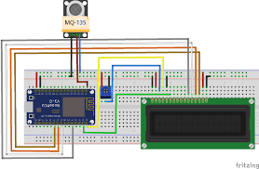
System Requirements
Hardware Requirements:
MQ135 Gas sensor
Arduino Uno
Wi-Fi module ESP8266
16X2 LCD • Breadboard
10K potentiometer
1K ohm resistors
220 ohm resistor
Buzzer
Software Requirements:
ARDUINO 1.6.13 software
Embedded c language

Slide 12
EXISTING SYSTEM
The commercial meters available in the market are Fluke CO-220 carbon monoxide meter for CO, Am probe CO2 meter for CO2, ForbixSemicon LPG gas leakage sensor alarm for LPG leakage detection. The researchers in this field have proposed various air quality monitoring systems based on WSN, GSM and GIS. Now each technology has limited uses according to the intended function, as Zigbee is meant for users with Zigbee trans-receiver, Bluetooth.

Slide 13
Software Requirement Specification (SRS) Document Report Preparation
The SRS document provides information about the functional and Non-functional requirements of the project.
Functional Requirements:
MQ135 Gas sensor
Arduino Uno
Wi-Fi module ESP8266
16X2 LCD • Breadboard
10K potentiometer
1K ohm resistors
220 ohm resistor
Buzzer

Slide 14
Software Requirement Specification (SRS) Document Report Preparation
Non Functional Requirements
These are basically the quality constraints that the system must satisfy according to the project contract. They are also called non behavioral requirements.
They basically deal with issues like:
1.Portability
2.Usability
3.Accuracy
4.Performance
5.Scalability

Slide 15
Proposed System
In this project we are going to make an IOT Based Air Pollution Monitoring System in which we will monitor the Air Quality over a web server using internet and will trigger a alarm when the air quality goes down beyond a certain level, means when there are sufficient amount of harmful gases are present in the air like CO2, smoke, alcohol, benzene and NH3. It will show the air quality in PPM on the LCD and as well as on webpage so that we can monitor it very easily.

Slide 16
Algorithm and Explanation
// include the library code:
#include <LiquidCrystal.h>
// initialize the library with the numbers of the interface
pinsLiquidCrystal lcd(12, 11, 5, 4, 3, 2);
int pin8 = 8;
int analogPin = A0;
int sensorValue = 0; // store the value readvoid setup() {
pinMode(analogPin, INPUT);
pinMode(pin8, OUTPUT);
// set up the LCD's number of columns and rows:
lcd.begin(16, 2); // Print a message to the LCD.
lcd.print("What is the air ");
lcd.print("quality today?");
Serial.begin(9600);
lcd.display();
}

Slide 17
void loop() {
delay(100);
sensorValue = analogRead(analogPin); // read the input pin
Serial.print("Air Quality in PPM = "); Serial.println(sensorValue); // debug value
lcd.clear();
lcd.setCursor(0,0);
lcd.print ("Air Quality: ");
lcd.print (sensorValue);
if (sensorValue<=500)
{
Serial.print("Fresh Air ");
Serial.print ("\r\n");
lcd.setCursor(0,1);
lcd.print("Fresh Air");
}
else if( sensorValue>=500 && sensorValue<=650 ) {
Serial.print("Poor Air");
Serial.print ("\r\n");
lcd.setCursor(0,1);
lcd.print("Poor Air");
}

Slide 18
else if (sensorValue>=650 ) {
Serial.print("Very Poor Air");
Serial.print ("\r\n");
lcd.setCursor(0,1);
lcd.print("Very Poor Air");
}
if (sensorValue >650) {
// Activate digital output
digitalWrite(pin8, HIGH);
}
else {
// Deactivate digital output
digitalWrite(pin8, LOW);
}
}

Slide 19
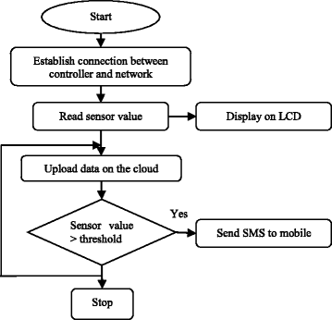
Design

Slide 20
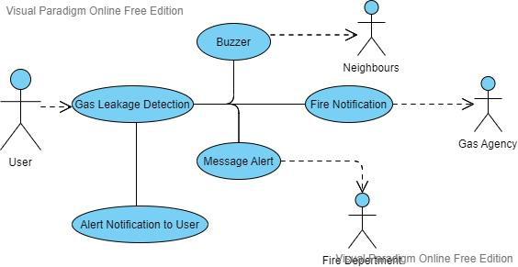
Design
USE CASE DIAGRAM

Slide 21
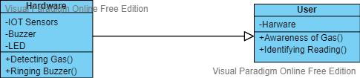
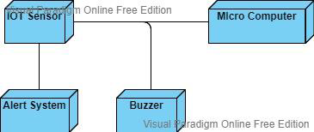
Class Diagram
Deployment Diagram

Slide 22
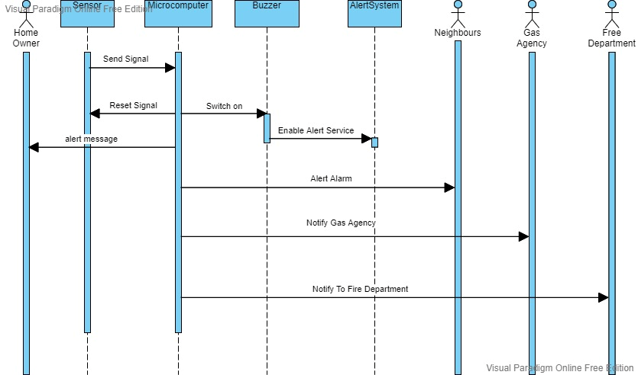
SEQUENCE DIAGRAM

Slide 23
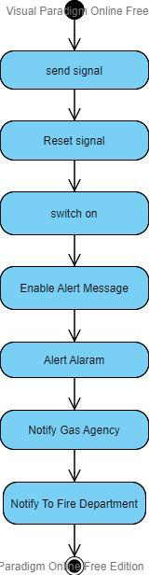
ACTIVITY DIAGRAM

Slide 24
Implementation
https://www.tinkercad.com/things/k1Ku0n0WZ2D-copy-of-air-pollution-monitoring-system/editel?sharecode=l7prCKWKI1fBQGt2ftlBjAFho9ogjQauq2lynZKHQB0

Slide 25
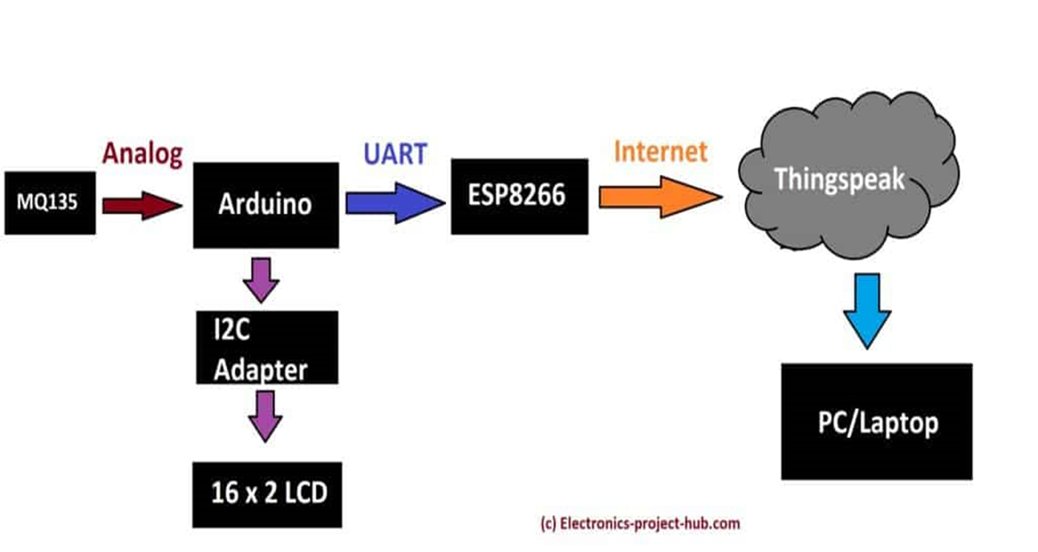
WORKING

Slide 26
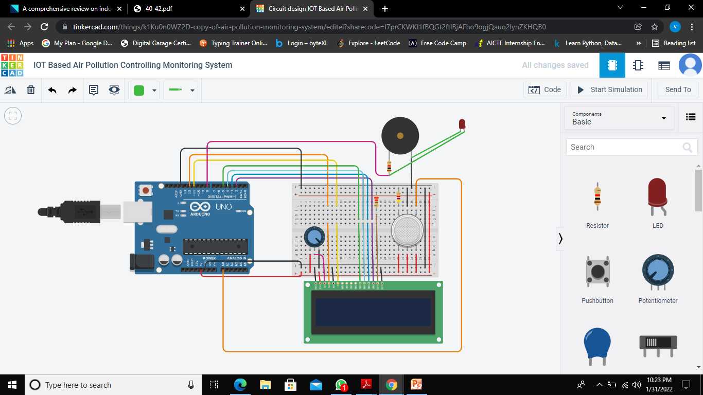
Screenshots

Slide 27
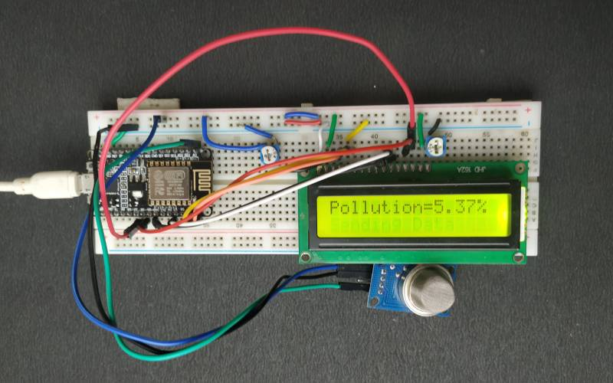
Screenshots

Slide 28
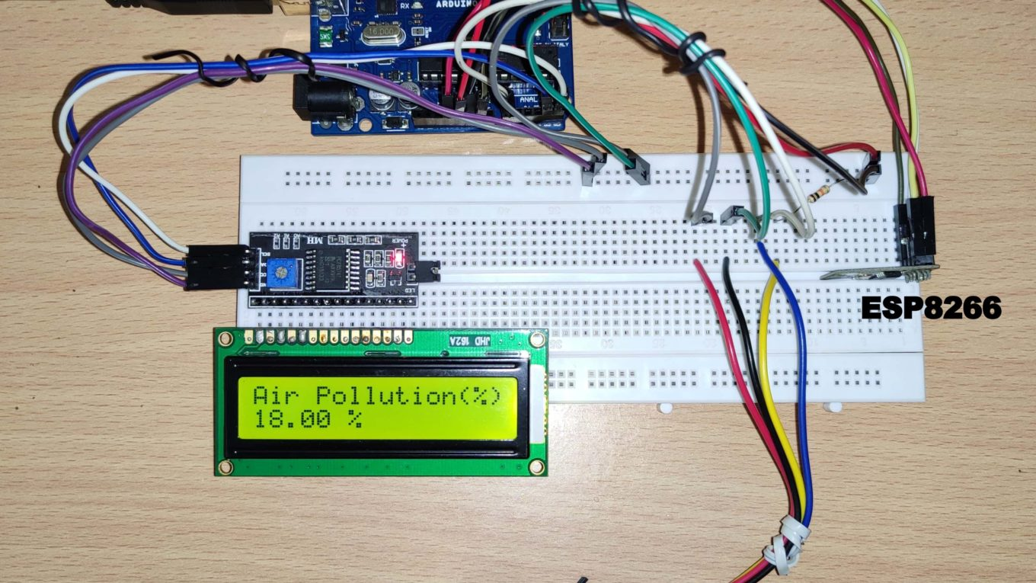

Slide 29
Societal Applications
Industrial perimeter monitoring
Indoor air quality monitoring.
Site selection for reference monitoring stations.
Making data available to users easily with cheap cost.
To prevent health hazards from the causes of pollution.
Helps to detect the amounts of harmful gases present in the air and helps in monitoring .

Slide 30
References
Ayaskanta Mishra assistant Professor, school of Electronics Engineering, Kalinga Institute of Industrial Technology (KIIT) Deemed to be University.
Anand Jayakumar A1, Praviss Yesyand T K2, Venkatesh Prashanth K K3, Ramkumar K4 ,1Asst. professor, Dept. of mechanical Engineering, Sri Ramakrishna Institute of Technology, India ,2,3,4Student, Dept. of mechanical Engineering, Sri Ramakrishna Institute of Technology, India.
Gagan Parmar, Sagar Lakhani, Manju K. Chattopadhyay ,School of Electronics ,Devi Ahilya University

Slide 31
Queries

Slide 32
Thank You!

